Slide 1

Cover page
Senior Data Engineer
ID, Access & Integration services Team, iSolutions
Grade 5
£45,161 to £56,921
Reference: 2863424JF
Closing Date: 11/10/24
Location: Hybrid - 1 Guildhall Square, Southampton, SO14 7FP & Home working

Slide 2
Contents
Diversity & Inclusion
The Department
The Role
Salary & Benefits
Application Process
FAQs
Contact Us
Candidate Information Pack
Page 2

Slide 3

Diversity and Inclusion
Diversity and Inclusion
People are our University. With greater diversity and inclusivity to reflect society, we will enable our education, research and enterprise to transform the communities we serve. We believe equality, diversity and inclusion are fundamental to making the University of Southampton a welcoming, vibrant and successful organisation.
Having a diverse workforce, inclusive of people of all ages and beliefs, from different cultural, educational and social backgrounds opens up a wealth of possibilities, makes us more creative and accelerates our impact on society.
We welcome applicants that value the diversity of our community and are willing to play their part in supporting the mission of inclusivity.
If you have a genuine interest in cyber security, are interested in helping our University become a more secure place to work, and believe you have what it takes to do this role, we want to hear from you, no matter what your previous career background.
You can learn more about the University’s commitment to Equality, Diversity, and Inclusion here.
Candidate Information Pack
Page 3

Slide 4


Welcome Message
The Department
”This is an exciting role where you can play a critical part in the implementation of the new Data Integration project
Thank you for your interest in the role of Senior Data Engineer for the University of Southampton.
This is a key role in support of the IAM project.
Your role will be critical in ensuring the implementation of a modern Cloud solution aligned with a robust governance structure to provide a platform that underpins the University’s Digital aims for Organisational Excellence.
In 2022 the University launched its strategy to inspire the remarkable, and I hope you’d like to be part of that journey with us.
We have a strong focus on building an inclusive environment where every member of my team feels valued and able to share their experiences and skills, and I welcome applications from candidates who share this ethos.
Apply now and be part of our commitment to maintaining a secure and resilient cyber environment for our University community.
Stewart Mangnall
Team Manager - ID, Access & Integration Services
Candidate Information Pack
Page 4

Slide 5
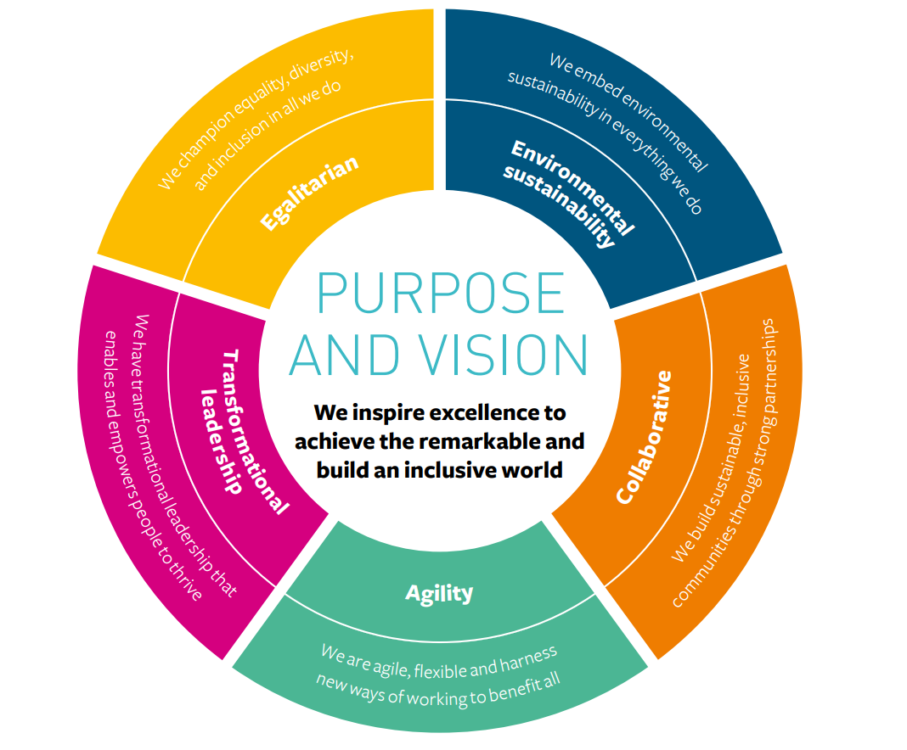
iSolutions
The Department
The Integration and Automation services team sits within iSolutions, the IT department of the University of Southampton. We report directly to our Executive Director and CIO, Mal Allerton.
We directly support the University Vision to:
“Inspire excellence to achieve the remarkable and build an inclusive world”.
iSolutions is a team of 260 staff supporting around 6000 staff and more than 20,000 undergraduate and postgraduate students. This makes us one of the largest universities in the southeast.
We have a vibrant and modern campus in the Highfield area of Southampton, as well as satellite campus in Winchester.
iSolutions itself is split between the main Highfield campus and our office in the heart of Southampton at 1 Guildhall Square next to the iconic Southampton Guildhall.
Candidate Information Pack
Page 5

Slide 6
The Role
The Role
This is an opportunity to play a key role in implementing the University’s Cloud solution.
You’ll report to the Team Manager of ID, Access & Integration services and assist with the implementation of the Data Integration project. Together with those other members of the team you will deliver our new operating platform. You’ll be working closely with the rest of the Integration and Automation services team, other members of the University’s IT department, 3rd party contractors and colleagues across the University to help make sure that all our new solution is able to have increased complexity and expansion opportunities whilst also improving the security of our systems and our data.
What you will do:
Work closely with current staff members and 3rd Party provider to implement the new IAM systems.
Take a leading role in the planning of major systems installations.
Produce and maintain detailed, well-structured documentation to assist with the handover at the end of the project.
Deliver coaching and mentor colleagues within the team.
What you will Bring:
Experience of the implementation of an MS Azure solution
Experience of the MS Azure platform
Use of Logic Apps, Service Bus, APIM, Grid, ADF, Azure Functions & Azure Synaps
The integrity required to work with both commercially sensitive and personally identifiable information.
Candidate Information Pack
Page 6

Slide 7
Salary and Benefits
Salary and Benefits
Salary
Circa £45,163 to £56,921
This is a senior role at the University’s Grade 5.
Contract type
This is a 18mth Fixed Term role, available for full time, part time or flexible working.
Full time hours would normally be 35 hrs over Monday to Friday. Salary would be pro-rata for anything less than 35 hrs/week.
Alternative working patterns can be discussed with the hiring manager at interview.
Is there any requirement for 24/7 working?
There is no current requirement for 24/7 working.
Are there any line-management responsibilities?
Yes, you will be supervising, coaching and mentoring others within the team.
Where will the role be based?
If successful for this role you will be formally based at 1 Guildhall Square, Southampton, SO14 7FP.
iSolutions is currently working under a hybrid arrangement. With this position there will possibly be requirements to attend on site meeting otherwise it will be remote working.
Benefits
Whatever your role, we take your career and development seriously, and want to enable you to build a successful career within the University. We believe that is is crucial that our employees have the right skills to develop their careers and meet the challenges ahead, and you’ll benefit from regular performance and development reviews to ensure this development is ongoing. As a University employee, you’ll be entitled to a large range of benefits.
This includes:
A generous holiday allowance of 30 days leave after a qualifying period, plus 6 University closure days plus standard bank holidays, totalling around 14 additional days' leave over and above your holiday allowance.
Leave for emergency domestic situations e.g. accident or sudden illness of children or other dependants
Generous contractual maternity pay for those employees with at least 52 weeks service by the 15th week before the expected week of childbirth, which consists of full contractual pay for 26 weeks followed by 13 weeks statutory maternity pay.
A maximum of 2 weeks’ paternity leave with full pay to enable an employee to be present at the birth of their child and/or meet family responsibilities after the birth.
Adoption leave is available to recognise the needs of staff who adopt children.
Membership of the Universities Superannuation Scheme pension.
Flexible working allows staff to change their patterns or total hours of working through discussions with their manager (taking into consideration the needs of the business).
Sport and Wellbeing membership offers staff and their families the chance to use the University’s sporting facilities at a special rate.
All staff have access to a private health care scheme. This provides an optional discounted health care scheme for employees with reduced rates for individual or family membership.
Staff can also cover the cost of routine dental treatments such as examinations, extractions and fillings with a dental plan, provided by Unum Dental.
Staff have access to a wide range of local and national retail, leisure and service discounts. These include restaurants, travel, local shops, entertainment, health and fitness facilities, hair and beauty services and many more.
For full details of all available benefits, please visit our dedicated benefits page.
Candidate Information Pack
Page 7

Slide 8
The Application Process
The Application Process
Application
Shortlist
Interview
Offer
To apply for this role, you will need to complete the online application process, outlined below.
The application deadline is midnight on the closing date stated on the front page.
Application
You will be asked to provide:
A CV setting out your career history with key responsibilities and achievements.
A Statement of Suitability (no longer that 1250 words) where you can explain how your unique set of skills, experiences, and qualities provide evidence of your suitability for this role. You should look to demonstrate your technical knowledge as well as how you meet the other criteria set out in the person specification.
Shortlisting
Once we receive your application, a panel – including the hiring manager – will assess your application and shortlist by considering all the evidence you provided in your CV and supporting statement.
Interview
If you are shortlisted, you will be invited to interview – either in-person at or remotely via Microsoft Teams. You may be asked to discuss a piece of coding during your interview. Interviews are usually 60-90 minutes in length, and you will be given plenty of opportunity to ask questions - we believe you are interviewing us as much as we are interviewing you.
Please note that we will not be able to reimburse expenses relating to the recruitment process or interview.
Offer
Regardless of the outcome, we will notify all candidates as soon as possible.
If you need assistance, call our recruitment team on +44 (0) 23 8059 2750, or email recruitment@soton.ac.uk quoting the reference number on the front page.
Candidate Information Pack
Page 8

Slide 9
FAQs
FAQs
What reasonable adjustments can be made if I have a disability?
We are committed to making reasonable adjustments in order to support disabled job applicants and ensure that you are not disadvantaged, including during the recruitment and assessment process.
Reasonable adjustments during recruitment could include; allowing extra time during selection tests; ensuring that information is provided in an accessible format or; by providing training.
If you feel that you may need a reasonable adjustment to be made, or you would like to discuss your requirements in more detail, please contact: recruitment@soton.ac.uk in the first instance.
Is this role suitable for part-time working?
This role is available for full-time, part-time or flexible working arrangements (including job share partnerships and condensed working hours) but you should discuss your needs with the hiring manager if you are invited to interview.
Is this role available for 100% remote working?
The University does not currently offer 100% remote working contracts so you will be expected to attend your formal place of work in line with current hybrid working guidelines.
Are there any travel requirements?
You may on occasion be based to travel to the main University campuses in the south Hampshire area; Highfield, Avenue, and our waterfront sites in Southampton, and the Winchester School of Art, but there is no regular need for you to travel further.
What IT equipment does the University provide?
All staff members are entitled to a Windows laptop and associated peripherals (keyboard, mouse, headset) as standard. If you would prefer, we can provide an Apple MacBook as an alternative.
If you require specialist accessibility equipment (trackpads, specialised keyboards, etc) please discuss this with the hiring manager.
For home working, please note that the University does not provide desks, chairs, or other office equipment.
What training and development is available?
The University has plenty of opportunities for you to advance your career through various learning activities, including formal training and certifications if that interests you. Talk to your hiring manager for more information.
Candidate Information Pack
Page 9

Slide 10





Final page
Contact us
For more information about this role please contact recruitment@soton.ac.uk
Quote the role reference on all correspondence.
Connect with us
https://www.southampton.ac.uk/

